Slide 1
Sequence Alignment Non-Gap Penalties and Gains
Justin Bass

Slide 2
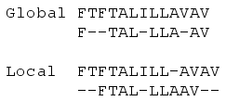
Sequence Alignment
Align two sequences with variations
Must account for indels, SNPs, CNVs
Notes:
This paper is looking at global alignment algorithms only.

Slide 3
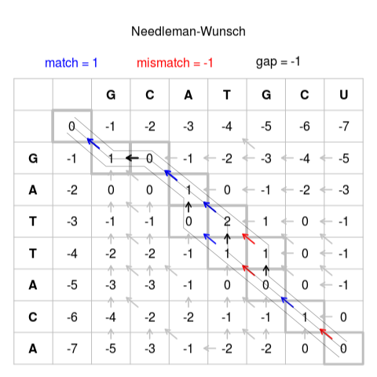
Sequence Alignment
Needleman-Wunsch (1970)
Dynamic Programming: O(N^2)

Slide 4
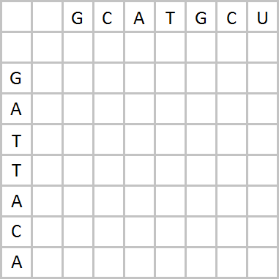
Needleman-Wunsch
Match (+1), Mismatch (-1), Gap Penalty (-1)
max(top - gap, diag + match, left – gap) or max(top - gap, diag - mismatch, left - gap)
0
-1
-2
-3 -4 -5 -6 -7
-1
+1
1
-2
Notes:
At each point, choose max(top - gap, diag + match, left - gap) if chars match, else max(top - gap, diag - mismatch, left - gap)

Slide 5
Needleman-Wunsch
Match (+1), Mismatch (-1), Gap Penalty (-1)
GC
G -
max(top - gap, diag + match, left – gap) or max(top - gap, diag - mismatch, left - gap)
So far:
0
-1
-2
-3 -4 -5 -6 -7
-1
1
-3
0
0
-2

Slide 6
Needleman-Wunsch
Match (+1), Mismatch (-1), Gap Penalty (-1)
0
-1
-2
-3 -4 -5 -6 -7
-1
1
0 -1 -2 -3 -4 -5
-2 0 0 1 0 -1 -2 -3
-3 -1 -1 0 2 1 0 -1
-4 -2 -2 -1 1 1 0 -1
-5 -3 -3 -1 0 0 0 -1
-6 -4 -2 -2 -1 -1 1 0
-7 -5 -3 -1 -2 -2 0 0

Slide 7
Needleman-Wunsch
Match (+1), Mismatch (-1), Gap Penalty (-1)
GCA-TGCU
G -ATTACA
Prefer a non-gap
Optimal Alignment: Score: 0 (4-2-2)
0
-1
-2
-3 -4 -5 -6 -7
-1
1
0 -1 -2 -3 -4 -5
-2 0 0 1 0 -1 -2 -3
-3 -1 -1 0 2 1 0 -1
-4 -2 -2 -1 1 1 0 -1
-5 -3 -3 -1 0 0 0 -1
-6 -4 -2 -2 -1 -1 1 0
-7 -5 -3 -1 -2 -2 0 0

Slide 8
Gap Penalty
These are all linear (4 sequential gaps: -4)
Common: Affine (penalty cost for opening gap)
Indels in nature follow a power distribution, suggesting a log gap penalty [Gu, et. Al. 1995]

Slide 9
Log-Affine Gap Penalty
Log gaps decrease accuracy [Cartwright 2006]
Most accurate is log-affine:
GP(L) = -1 - L - ln(L)
… but almost negligibly more than affine

Slide 10
Affine Gap Penalty
Match (+1L), Mismatch (-1L), Gap Penalty (-3 - L)
0
-4
-5
-6 -7 -8 -9 -10

Slide 11
Log Gap Penalty
Match (+1L), Mismatch (-1L), Gap Penalty (-1-ln(L))
GP(2) = -1-ln(2) = -1.69
GP(1) = -1-ln(1) = -1
0
-1
-1.69
-2.10 -2.39 -2.61 -2.79 -2.95

Slide 12
Non-Gap Penalty and Gain
Why not use complex functions on matches and mismatches, rather than just linear?
Constant increase in time complexity (~4-5x)

Slide 13
Non-Gap Penalty and Gain
4 matrices needed to store sequential lengths
Horizontal Gap, Vertical Gap, Diagonal Matches, Diagonal Mismatches
0 -1 -2 -3 -4 -5 -6 -7
-1 1 0 -1 -2 -3 -4 -5
-2 0 0 1 0 -1 -2 -3
-3 -1 -1 0 2 1 0 -1
-4 -2 -2 -1 1 1 0 -1
-5 -3 -3 -1 0 0 0 -1
-6 -4 -2 -2 -1 -1 1 0
-7 -5 -3 -1 -2 -2 0 0

Slide 14
Non-Gap Penalty and Gain
Sequential Horizontal Gaps
0 -1 -2 -3 -4 -5 -6 -7
-1 1 0 -1 -2 -3 -4 -5
-2 0 0 1 0 -1 -2 -3
-3 -1 -1 0 2 1 0 -1
-4 -2 -2 -1 1 1 0 -1
-5 -3 -3 -1 0 0 0 -1
-6 -4 -2 -2 -1 -1 1 0
-7 -5 -3 -1 -2 -2 0 0

Slide 15
Non-Gap Penalty and Gain
Horizontal Gap Length Matrix (H)
For each cell (Y,X): Score[Y,X] = Score[Y,X-1] + GP(H[Y,X]) - GP(H[Y,X-1])
0 0 0 0 0 0 0 0
0 0 1 2 3 4 5 6
0 0 0 1 2 3 4 5
0 0 0 0 0 1 2 3
0 0 0 0 0 0 1 2
0 0 0 0 0 0 0 1
0 0 0 0 0 0 0 1
0 0 0 0 1 0 0 0

Slide 16
Non-Gap Penalty and Gain
Match Length Matrix (Dm)
For each cell (Y,X): Score[Y,X] = Score[Y-1,X-1] + MG(H[Y,X]) - MG(H[Y-1,X-1])
0 0 0 0 0 0 0 0
0 1 0 0 0 1 0 0
0 0 0 1 0 0 0 0
0 0 0 0 2 0 0 0
0 0 0 0 1 0 0 0
0 0 0 0 0 0 0 0
0 0 1 0 0 0 1 0
0 0 0 2 0 0 0 0

Slide 17
Testing
Generate a random string with length 100 -> STR1
Add random SNPs, Indels (biologically accurate, Gu et. al. 1995), and CNVs to 5% of STR1 -> STR2
Example:
STR1 = …ACTAGTAGTATCAGTA
STR2 = …_CTGGTAGTATCAGTGGAAAAA

Slide 18
Testing
Keep track of generated variations
Return known matches, mismatches, indels
Run algorithms to align STR1 & STR2
Return measured matches, mismatches, indels
Score = matches / (matches + mismatches + indels)
Accuracy = Measured Score / Known Score
Has low variance between runs with 100 trials per alg.
That is, 100 STR1’s

Slide 19
Testing
Tested 11 scoring functions for matches, mismatches, and gap penalties
None [0]
Linear [L]
Affine [1 + L]
Affine-log [L + ln(L+1)]
Affine-log2 [1 + L + ln(L+1)]
Log [ln(L+1)]
Log2 [1+ln(L+1)]
Quad [L^2]
Quad2 [1+L^2]
SubQuad [L^1.5]
SubQuad2 [1+L^1.5]
Simple coefficients (0&1) to reduce this number
Thus, 11x11x11 combinations of functions

Slide 20
Results
Generates table with 11*11*11 accuracy scores
One per combination of functions
Collapse into
11 accuracy scores for match functions
11 accuracy scores for mismatch functions
11 accuracy scores for gap functions
Gives average performance for each across all other 11*11 combinations of functions

Slide 21
Results
Scores | Match (mean) | Match (std) | Mismatch (mean) | Mismatch (std) | Gap (mean) | Gap (std)
None | 0.670 | 0.140 | 0.611 | 0.105 | 0.627 | 0.078
Linear | 0.822 | 0.099 | 0.739 | 0.102 | 0.768 | 0.087
Affine | 0.737 | 0.100 | 0.775 | 0.097 | 0.802 | 0.095
AffineLog | 0.758 | 0.099 | 0.757 | 0.100 | 0.783 | 0.097
AffineLog2 | 0.615 | 0.088 | 0.779 | 0.096 | 0.788 | 0.099
Log | 0.729 | 0.100 | 0.688 | 0.112 | 0.671 | 0.103
Log2 | 0.565 | 0.088 | 0.747 | 0.106 | 0.742 | 0.110
Quad | 0.812 | 0.100 | 0.743 | 0.101 | 0.722 | 0.107
Quad2 | 0.807 | 0.100 | 0.777 | 0.095 | 0.733 | 0.121
SubQuad | 0.813 | 0.100 | 0.739 | 0.102 | 0.737 | 0.102
SubQuad2 | 0.802 | 0.100 | 0.775 | 0.096 | 0.756 | 0.114
UNDERLINE: Best Score for each column
BOLD: Possible best score, not sure due to minor variance between runs
Gap (sanity check): Affine & AffineLog gaps are best, Log performs worse
Matches: Linear performs the best
Mismatches: Opening Penalties perform the best for several functions
Notes:
Another sanity check: None performs the worst of any function

Slide 22
Results
Gap Size | Match (gap num) | Match (gap len) | Mismatch (gap num) | Mismatch (gap len) | Gap (gap num) | Gap (gap len)
None | 34.232 | 8.163 | 31.886 | 3.584 | 52.181 | 3.240
Linear | 24.651 | 2.484 | 34.522 | 2.627 | 34.195 | 2.202
Affine | 37.053 | 1.912 | 33.932 | 2.523 | 26.677 | 2.683
AffineLog | 34.315 | 2.032 | 34.913 | 2.576 | 28.426 | 2.450
AffineLog2 | 54.411 | 1.576 | 34.173 | 2.508 | 25.554 | 2.956
Log | 32.575 | 2.131 | 35.420 | 2.919 | 48.685 | 3.304
Log2 | 53.705 | 1.583 | 34.525 | 2.634 | 37.949 | 4.665
Quad | 26.205 | 2.527 | 34.966 | 2.536 | 34.340 | 1.712
Quad2 | 27.246 | 2.336 | 34.254 | 2.485 | 27.494 | 2.146
SubQuad | 25.854 | 2.503 | 35.033 | 2.554 | 34.778 | 1.859
SubQuad2 | 27.678 | 2.210 | 34.302 | 2.510 | 27.646 | 2.241
Gap (sanity check): Opening penalties reduce gap number & increase gap length
Matches: Opposite of gaps (increase gap num, reduce gap len)
Mismatches: No discernible effect

Slide 23
Discussion
Changing Match function hurts accuracy
Increases match accuracy
Implicitly adds & groups indels, reducing score
Adding opening penalty to mismatch function slightly helps
Decreases mismatches
Has no effect on gaps

Slide 24

Future Work
Need to run for more functions
This project only included coefficients of 0 & 1
Similar studies test many coefficients [Cartwright 2006]
But the function grid is N*N*N when accounting for matches, mismatches * gap penalties!
Would take 10,000 years to run for more coefficients, EXPENSIVE!
All for a seemingly very small increase in accuracy

Slide 25
References
1. Needleman, SB & Wunsch, CD. (1970) A general method applicable to the search for similarities in the amino acid sequence of two proteins. J. Mol. Biol., 48:443-453.
2. Cartwright, Reed A. (2006) Logarithmic gap costs decrease alignment accuracy. BMC Bioinformatics, 7:527.
3. Gu X, Li WH: The size distribution of insertions and deletions in human and rodent pseudogenes suggests the logarithmic gap penalty for sequence alignment. J Mol Evol 1995, 40:464-473.
4. Mott, Richard. (1999) Local sequence alignments with monotonic gap penalties. Bioinformatics, 15(6):455-462.
5. Altscul, SF. (1998) Generalize affine gap costs for protein sequence alignment. Proteins, 32:88-96.

